Slide 1
THE CASE OF NIFTY

Slide 2
INTRODUCTION
The term ‘Nifty’ comes from the combination of the words ‘National’ and ‘Fifty,’ signifying its role as a benchmark index representing the performance of India's top 50 firms on the National Stock Exchange (NSE). Launched in April 1996, the Nifty has become one of the most significant and widely tracked indices in the Indian stock market.

Slide 3
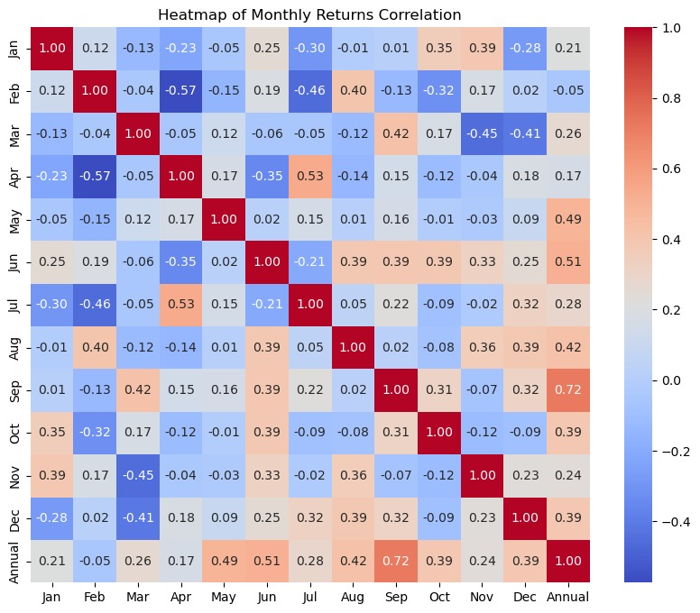
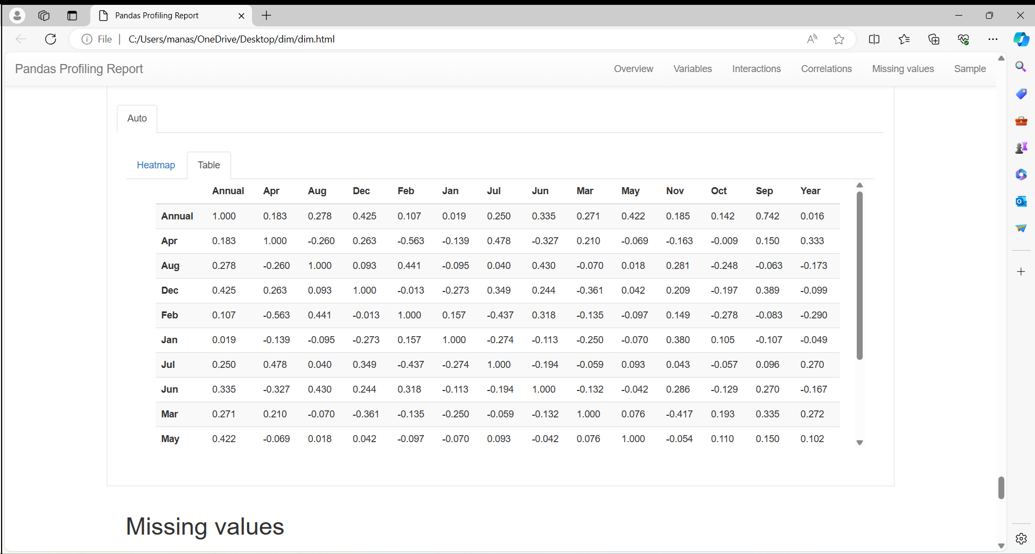
EDA
Correlations:
Heat map of the monthly returns

Slide 4
Dataset Statistics:
Number of variables | 14
Number of observations | 24
Missing cells | 0
Missing cells (%) | 0.0%
Duplicate rows | 0
Duplicate rows (%) | 0.0%
Total size in memory | 2.8 KiB
Average record size in memory | 117.3 B
Numeric | 14

Slide 5
ALGORITHMS
Logistic Regression
Random Forest
Gradient Boosting
Decision Tree
Support Vector Classifier

Slide 6
Logistic regression:
Accuracy: 0.6
Precision: 0.75
Recall: 0.75
F1 Score: 0.75

Slide 7
Random forest classifier:
Random Forest Classifier Metrics:
Accuracy: 0.8
Precision: 0.8
Recall: 1.0
F1 Score: 0.888888888888889
Gradient Boosting Classifier:
Gradient Boosting Classifier Metrics:
Accuracy: 0.6
Precision: 0.75
Recall: 0.75
F1 Score: 0.75
Decision tree classifier:
Mean Squared Error: 236.85836000000003
SVC:
Mean Squared Error: 1738.9365832206058

Slide 8
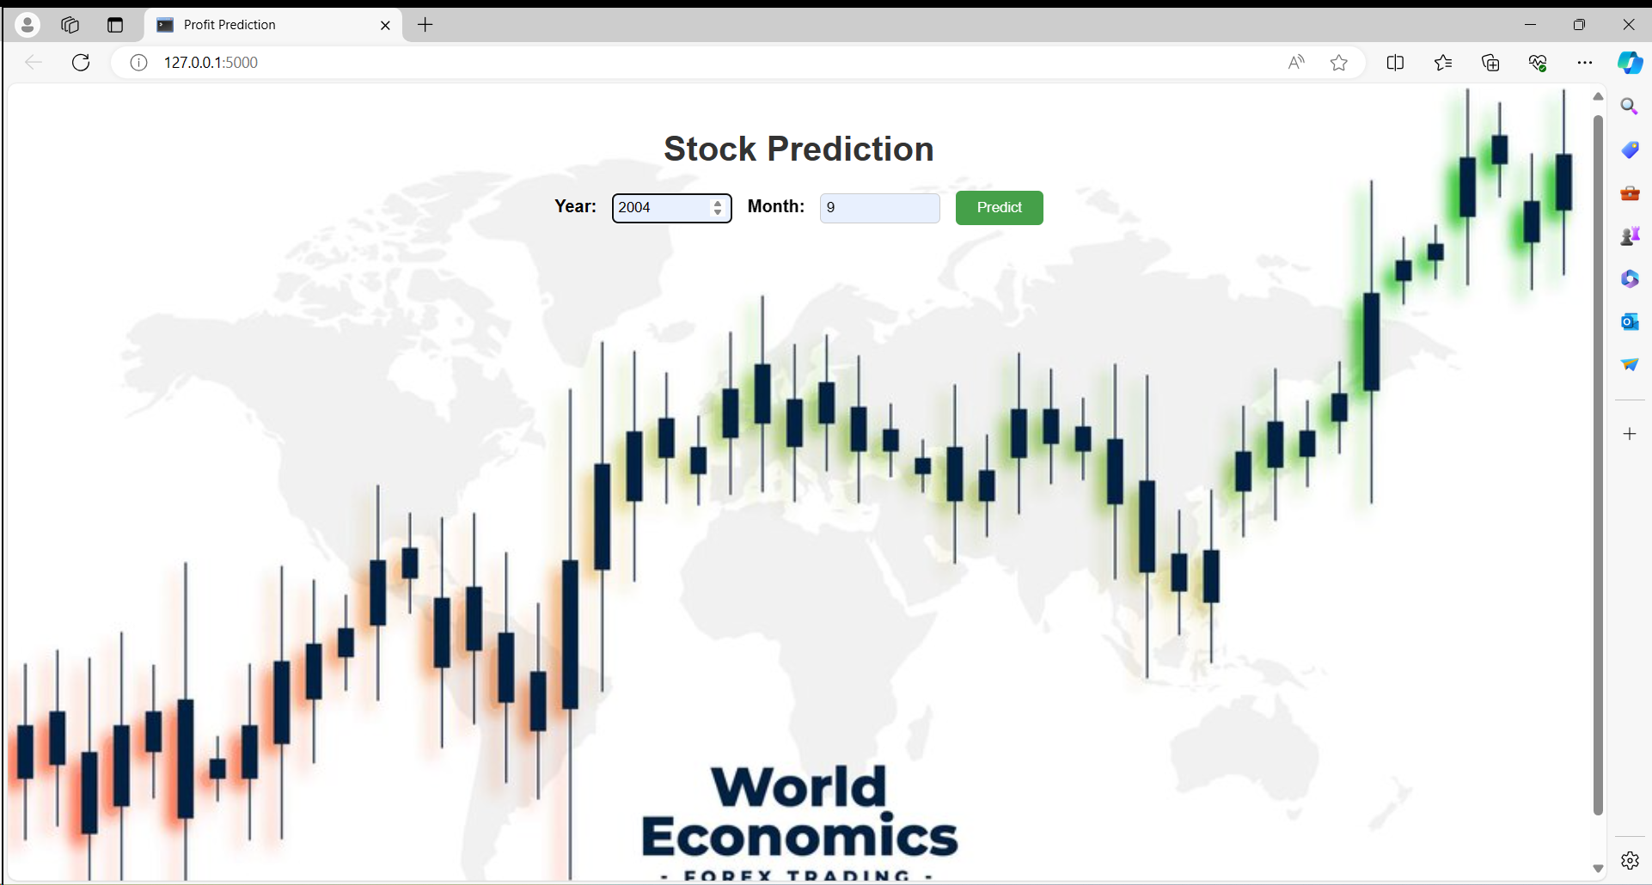
PREDICTING RESULTS
The project aims to provide a user-friendly interface for predicting Nifty returns, enabling users to make informed decisions based on historical data.

Slide 9
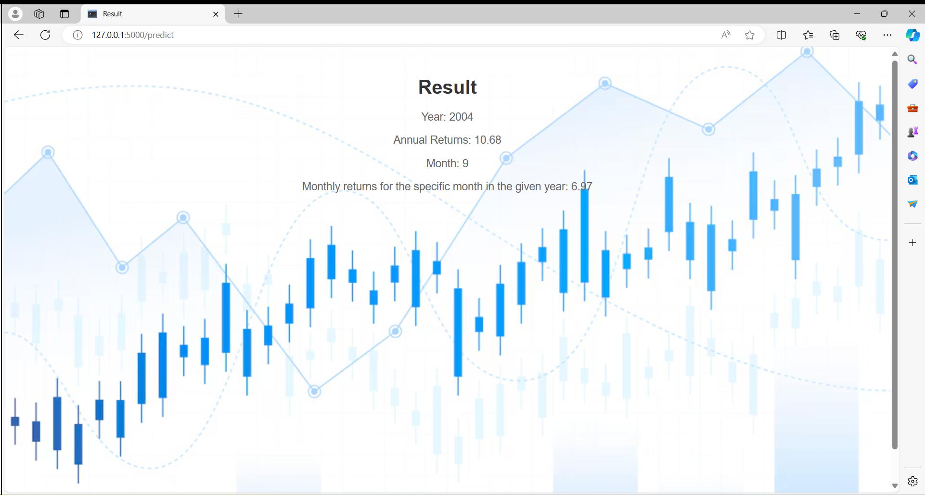

Slide 10


Slide 11


Slide 12
THANK YOU

